Slide 1

RATINGS Prediction Project
By
KOUSHIK BISWAS

Slide 2
TABLE OF CONTENTS
Abstruct
Introduction
Problem Statement
Conceptual Background of the Domain Problem
Data Sources and their formats
About The DataSet
Data Preprocessing
Hardware and Software Requirements and Tools Used
selected models
Accuracy score of the model
Parameter tuning
Final model
SHOW PREDICTED AND ORIGINAL Ratings
Interpretation of the Results
Conclussion

Slide 3
Abstruct
. Artificial Intelligence is an integral part of all major e-commerce companies today. Today's online retail platforms are heavily powered by algorithms and applications that use AI. Machine learning is used in a variety of ways, from inventory control and quality assurance in the warehouse to product recommendations and sales demographics on the website. Let’s say you want to create a promotional campaign for an e-commerce store and offer discounts to customers in the hopes that this might increase your sales. You have been provided descriptions of products on Amazon and Flipkart, including details like product title, ratings, reviews, and actual prices. In this challenge, you will predict discounted prices of the listed products based on their ratings and actual prices.

Slide 4
Introduction
Thousands of products are sold everyday. There are some questions every buyer asks himself like: What is the actual price that product deserves? Am I paying a fair price? Is it good product?
In this paper, a machine learning model is proposed to predict rating of a specific product based on data related to the reviews of a customer. This will facilitate the reproducibility of our work. In this study, Python programming language with a number of Python packages will be used.

Slide 5
Problem Statement
We have a client who has a website where people write different reviews for technical products. Now they are adding a new feature to their website i.e. The reviewer will have to add stars(rating) as well with the review. The rating is out 5 stars and it only has 5 options available 1 star, 2 stars, 3 stars, 4 stars, 5 stars. Now they want to predict ratings for the reviews which were written in the past and they don’t have a rating. So, we have to build an application which can predict the rating by seeing the review.

Slide 6
Conceptual Background of the Domain Problem
we are going to work on a dataset which consists information about the product reviews and ratings. When we work on these sorts of data, we need to see which word is important for us and which is not. Our main aim today is to make a model which can give us a good prediction of rating of a specific product. We are going to use Linear Regression for this dataset and see if it gives us a good accuracy or not.

Slide 7
Data Sources and their formats
I have scraped the product reviews data from amazon and flipkart. The dataset contains 37324 rows and 3 columns having both numerical and categorical data.
In this dataset " Ratings" is our target variable which has only 5 type(1,2,3,4,5) of data. So this is a “Classification type" problem.
you can download the my dataset from the below link.
Dataset link:
https://github.com/KBkoushik/RATINGS-PREDICTION/blob/cf68cad469396f5389ce8a602692341ed2335f60/Ratings%20Data(webscraping).xlsx

Slide 8
About The DataSet
Rating
Review
Long_review

Slide 9
Data Preprocessing
For the purpose of the project the dataset has been preprocessed as follows:
We have few missing values in the dataset. We drop this missing value
we divide all the columns into categorical and numerical types
Univariate Analysis Of Categorical Columns and numerical columns.
All the text in Review and Long Review columns changes into lower case
Adding length of Review and Long_review columns as a new columns
Replace Email address,url and phone number with email,webaddress and phonenumber respectively
Removing the pucntuations
writing function for the entire dataset
Lemmatizing and then Stemming with Snowball to get root words and further
reducing characters
Plot Word cloud of each rating
Dividing data into features and vectors
Oversampling for data balancing
Removing skewness by power transform method

Slide 10
Hardware and Software Requirements and Tools Used
Hardware:- Desktop/Laptop
Software:- Anaconda

Slide 11
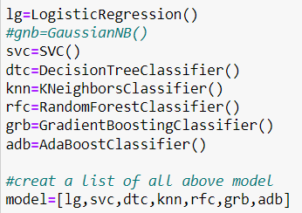
selected models
I used 7 different classification algorithms to get the ideal one for prediction.

Slide 12
Accuracy score of the model we can see that accuracy score of RandomForest and SVC is high compaire to other.now we have to check cross val score of this two model.
Model Name | Accuracy Score
LogisticRegression | 0.5820180763523539
SVC | 0.6546607311479833
DecisionTreeClassifier | 0.5631323350870093
KNeighborsClassifier | 0.5631323350870093
RandomForestClassifier | 0.6587076757048429
GradientBoostingClassifier | 0.5265074868474302
AdaBoostClassifier | 0.4825306893295562

Slide 13
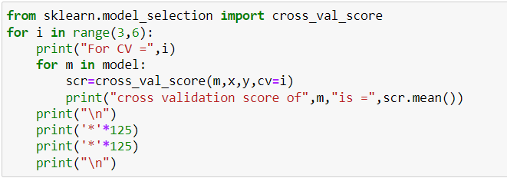
Cross Val Score
We can check cross val score by this code for all model which I stored in model variable
After Runing this code we get best cross val score from RandomforestRegressor for CV=5

Slide 14
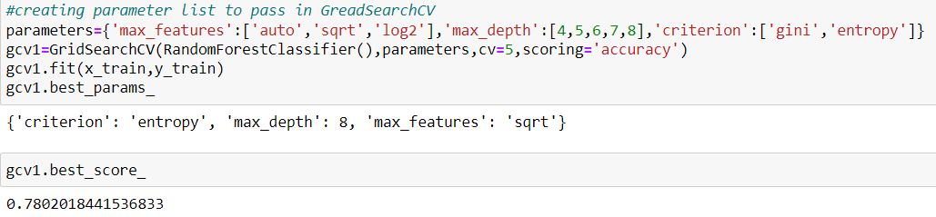
Parameter tuning
accuracy score has increased after parameter tuning RandomforestClassifier and.Now we will create final model with this Randomforest Classifier’s parameter which I get from prametertuning.

Slide 15
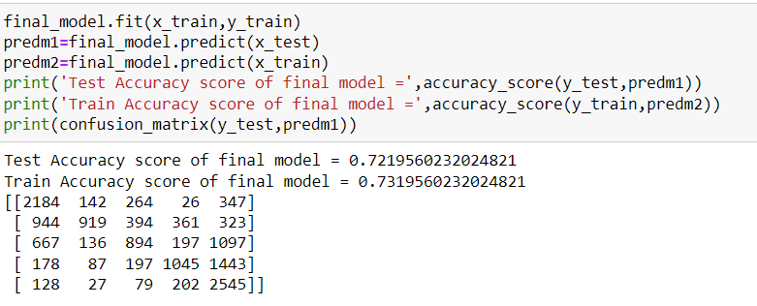
Final model
since difference between train accuracy and test accuracy is very less ,our final model is not overfit or underfit.

Slide 16
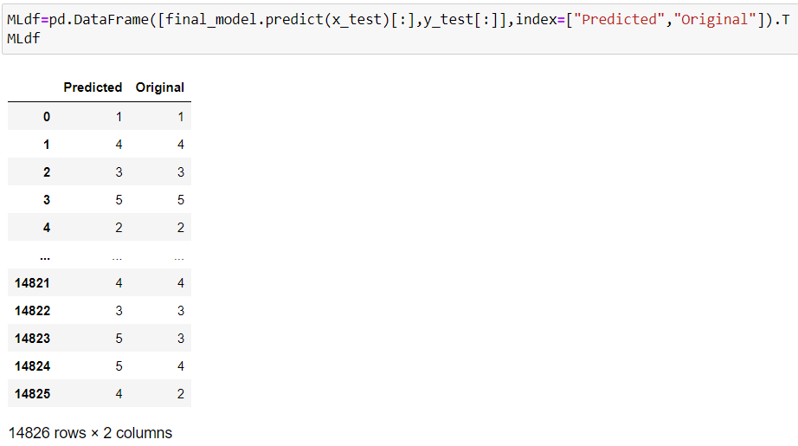
SHOW PREDICTED AND Original Ratings
We can see the difference between Predicted and original ratings.Most of the predicted ratings are same to the original ratings

Slide 17
Interpretation of the Results
We see that our model accuracy only 72%.we have to improve accuracy.Its possible only if I have more knowledge about NLP function.
At first we get only 58% accuracy from Logistic Regression.But finaly after parameter tuning we get 72% accuracy
It is always advised to all of us that atleast we need to use 5 Algorithm in order to figure out which one is performing best among them and we choose that one and we send that for hyper parameter tuning to know that best parameter .
Using hyper parameter tunning we can improve our model accuracy, for instance in this model the accuracy increased.

Slide 18
Future Work
For future improvements, following step we thought to took-
Replacing model with a latest/different model
Using other robust datasets
More focus on NLP properties

Slide 19
Conclussion
When I predict the ratings from the reviews we can see that a lot of complexity was involved. Some comments in the review are not meaningful due to some spelling mistakes. This is very critical to increase the accuracy score of a model.
For any of machine learning project my suggestion is first you have to understand the problem on ground level .if you don’t allow yourself to work with diligence .if you don’ t work harder anything that you are doing or will do , not only in case of machine learning but also in life cycle would be futile. Maybe, my endeavour assist you when ever you will get stuck

Slide 20
THANK YOU

